Slide 1
Backcountry Hiking Webmap
Team Leader: Zack Tucker
Team Members: Samuel Garza & Jonathan Whitmore
Client: Dr. Dan Goldberg

Slide 2
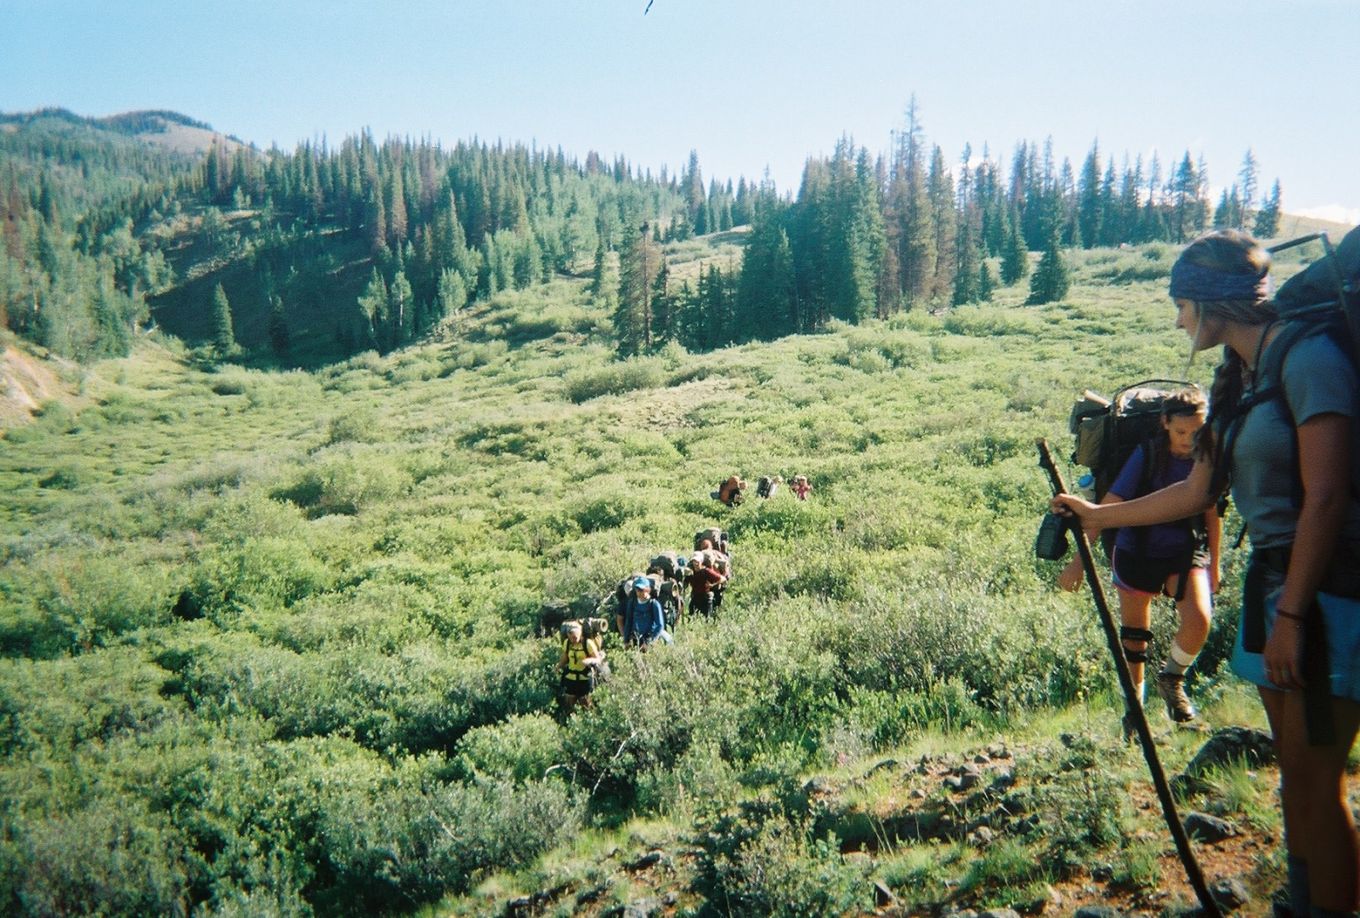
MOTIVATION: “How long will it take me to get from here to there?”
Previous ArcMap tool was too complicated for a user, and inaccessible.

Slide 3
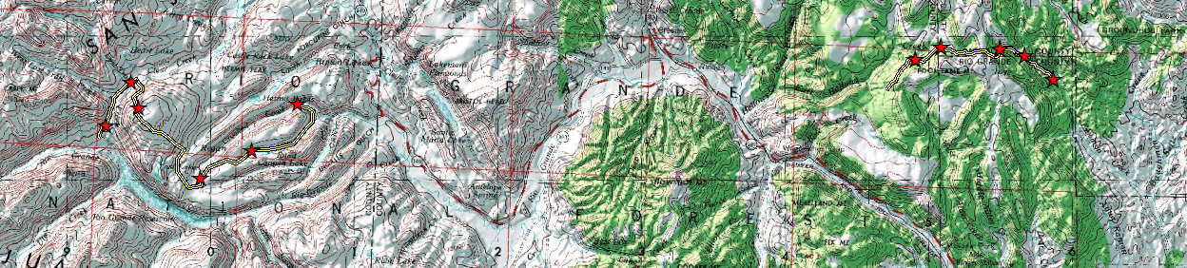
How it Works
Deliverables
Simple Webpage hosted on our virtual machines
Uses Google Maps API to create routes
Javascript functions create time statistics
User defined route visualizations
Point locations along routes
Time Calculations between the points and Total Distance.

Slide 4

Let’s test it out!
Try it on your phone or labtop!
geog478-46.geog.tamu.edu
Notes:
Here we will open the code and explain while in edit mode then run it on arc. The syllabus says we should demonstrate the code working for our final presentation. Opening the code, opening the website and running it will take up most of our presentation time.

Slide 5
Limitations
Improvements
Assumes specific break times for different hiking intervals
User needs access to the internet near TAMU
Buy a domain name
Improve the aesthetics of the website
Export the waypoints information to be used in other software
Clear last marker button for user errors
Save routes and Information (potential database needs)
MOBILE APPLICATIONS

Slide 6
Thanks and Gig’em
Our Client : Dr. Daniel Goldberg
Special Thanks: Xiao Li,
Chuck Taylor’s Coordinate Converter Algorithms @ http://home.hiwaay.net/~taylorc/toolbox/geography/geoutm.html,
Waldo R. Tobler and his other 1st Law.

Slide 7
Questions?

Slide 8
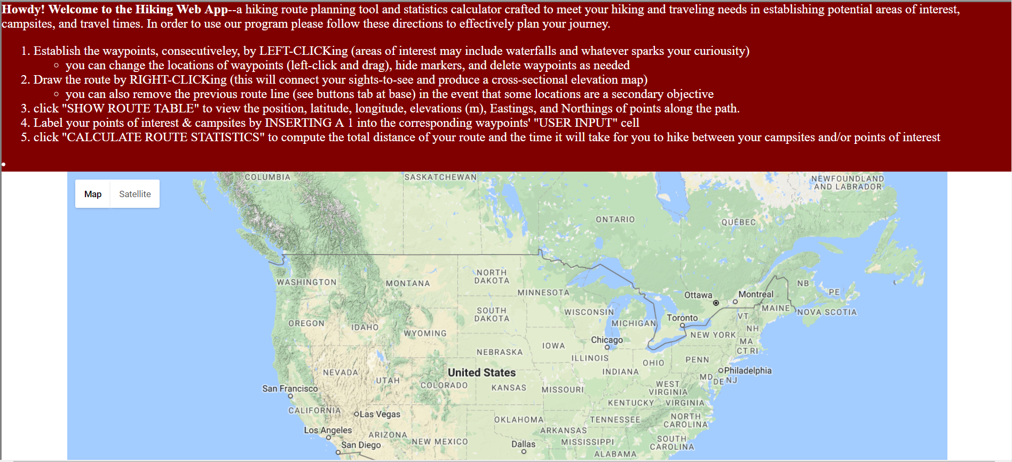
Opening the webpage

Slide 9
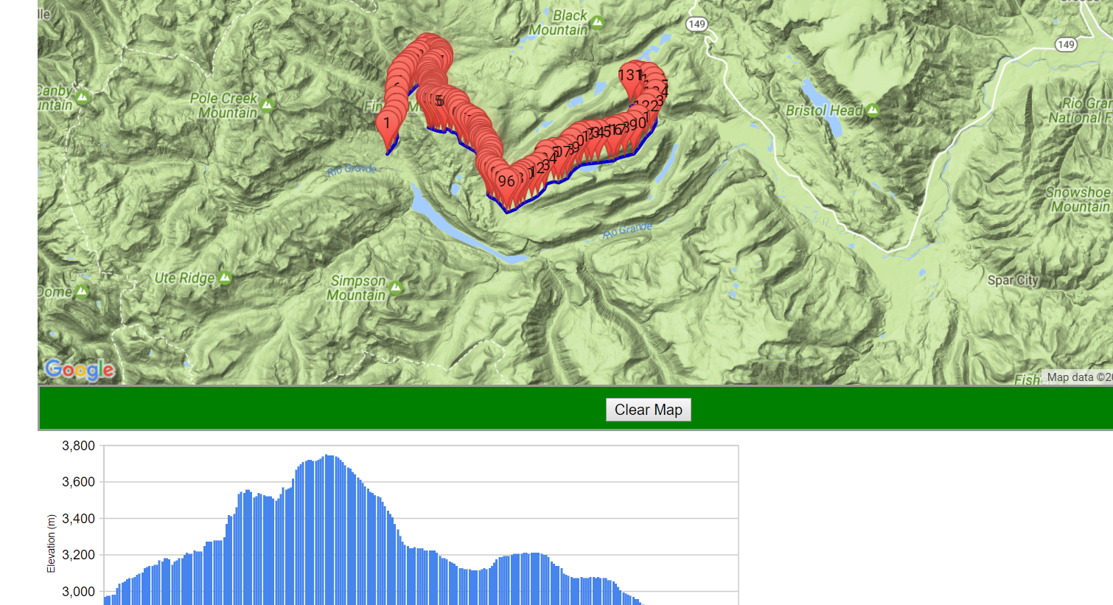
Step 1: Draw Your Route

Slide 10
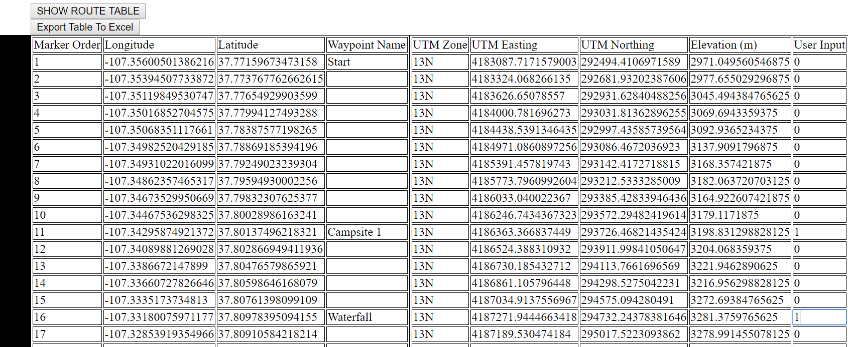
Step 2: Name and Define Your Campsites

Slide 11
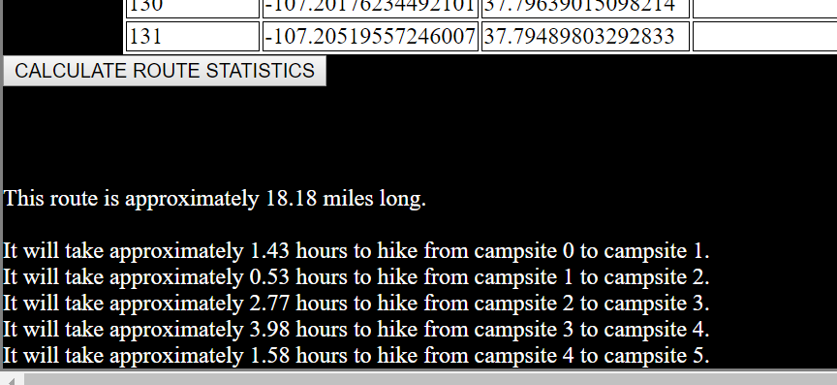
Step 3: Click a button and Wahlah!

